Slide 1
Week 4 Culture & Socialisation
SC1101E Kelvin Low Department of Sociology National University of Singapore

Slide 2
Guiding Questions
What is ‘Culture’?
What forms of Culture are there?
How does Culture socialise the individual?
How does Culture guide public behaviour?
How does Culture aid collective action?
How do we analyse Culture theoretically?
How do we study Culture in a period of globalisation?

Slide 3
CULTURE
Learning Culture - Socialisation
Using & Evaluating Culture – Concepts/ Theories
Culture & Globali-sation
Defining Culture – forms/ elements

Slide 4
Defining ‘Culture’
a shared way of life of a group of people -- the behaviours, beliefs, values, language, and symbols that they accept, generally without thinking about them, and that are passed along by communication and imitation from one generation to the next.
Culture is composed of the socially transmitted ideas, practices, and material objects that enable people to adapt to, and thrive in, their environments.
(Brym & Lie 2007: 64)
Notes:
Example the use of money notes, which is recognised by the community to have a monetary value to exchange for goods and services with the same value as compared to a self-drawn note without any warrant for cash or currency. Legal money? Shared of norms and culture that is associated with the use of money.
Example the use of ez-link card, we all associate that orange card with the need to pay for our public transport, and we are used to going to a bus stop to wait for public transport. It’s a social behaviour that is all are used to.
We as members of the society learned social norms.

Slide 5
Forms of Culture
Symbols – objects, gestures, images
Material components – physical objects including money, means of transportation, foods, clothes, etc.
Language – a system of verbal/written symbols with rules
Notes:
E.G can be seen in the different languages, and language is a part of culture

Slide 6

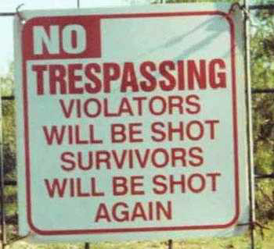
Forms of Culture
Norms (p.65)
Accepted ways of doing things in a particular situation
Written and unwritten rules
E.g. signs in restaurants (‘No Smoking Section’)
Notes:
What to do and what not to do in a particular situation.

Slide 7
Forms of Culture
Norms
Unwritten norms include
Wash hands after using the toilet
Remove shoes before entering the house
Remove armpit hair
Values
Shared conceptions of what is good, right, appropriate, and important with regard to conduct, appearance, and states of being
Notes:
Understood and shared knowledge and there are people who do not follow the norms. People do transgress the norms.
Eg. In the Asian culture it is understood that u take off ur shoes before entering the room. While for the western culture it is weird for u to do so.

Slide 8
Forms of Culture
Values
E.g.1 Individualism/ individual’s right to ‘life, liberty, and the pursuit of happiness’ (Declaration of Independence)
E.g.2 values of freedom, happiness, self-discipline, etc
Notes:
Intangible forms of values

Slide 9
Core Values
Service to students, stakeholders and partners Passion and integrity in all that we undertake Advancement of our university vision – A leading global university Relationships of value Keys to the world
National University of Singapore

Slide 10
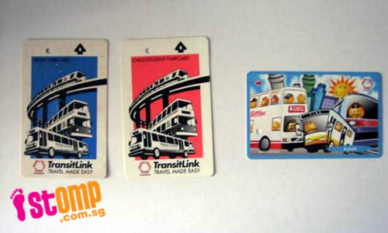
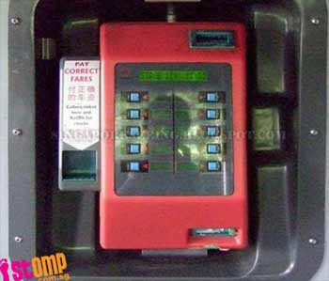
Elements of Culture
Open-ended – constantly added to over time with much borrowing from one part of the world to another (cf. Ralph Linton 1937[2002])
NOT static or ‘timeless’; Changes across time through invention, discovery, and diffusion
Individuals can interpret, select, manipulate, revive, and create Culture (‘add/drop’)
Notes:
Simply put the features of culture. People do borrow culture, and they is no authentic culture hundred percent unique to the country. Active modifiers of culture.

Slide 11
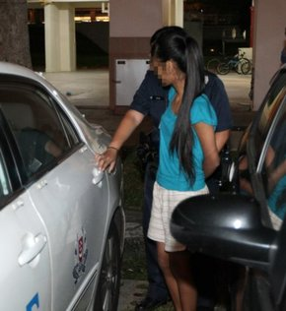
Sanctions (p.67) – aimed at conformity
Positive (praise; encouragement; money)
Negative (punishment; violence)
Example: Teenager who burnt Singapore flag (ST, 19 July 2012)
“It is an offence to treat the national flag with disrespect.
Under the Singapore Arms and Flag and National Anthem Act, offenders could be fined $1,000.
In addition, the Singapore flag may not be used for any commercial, advertising, furnishing or decorating purpose, unless express permission is granted by the authorities.” (ST, 19 July 2012)

Slide 12
Culture-Biology Relationship
Humans as social animals, with a biological capacity for Culture (e.g. language learning)
Mouse -------------- Mice
Formula ------------ Formulae
Cup ------------------Cups

Slide 13
Culture/Biology
Social context/feedback
Socially calibrated behaviour
Biological capacities (e.g. facial expression, language ability)
(1) Pte vs Sergeant (cf. Goffman’s ‘veneer of consensus’)
(2) TV and children
Notes:
We know when to use what and when not to do what.
In an particular environment of context.
Adults correct children when they are doing things wrong like the pronunciation and socially desired behaviours.

Slide 14
Culture & Socialisation
Agents of Socialisation
Families (primary socialisation)
Schools (secondary socialisation)
Peer groups
Mass Media
Enculturation - the process by which a person learns the requirements of the culture by which he or she is surrounded, and acquires values and behaviours that are appropriate or necessary in that culture
Notes:
How culture is socially transmitted through socialisation. Parent may not form the agents for primary socialisation. Manners, ethics, duty can be instilled in the children. As long as outside the family is considered as the secondary socialisation. Enculturation, is without purpose, while socialisation is an deliberate attempt to instil teachings. Both are similar because both tells us how culture is pick up, transmitted and employed.

Slide 15
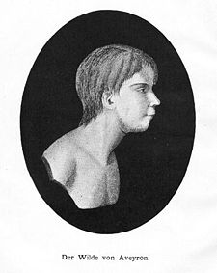
Culture & Socialisation
‘Wild Boy of Aveyron’ (1797)
Became case study during Enlightenment period; debate concerning differences between humans and animals
‘Civilising’ a wild child; taught him to speak and to show emotions
Notes:
Wild and undomesticated human being. Biologically he is a human, but he has not learned the social norm.
For victor, when he was nude, he played in the snow instead of reacting to the coldness of the snow. Socialising allows us to learn what is hot and what is cold and how do we response to the changes in temperatures. Language acquisition must be learned when the child reaches a period of linguistic potential and has the capacity for learning.

Slide 16
(1) Individual Biological potential for culture
(3) ‘Society’ Ongoing social relations; social structures
(2) ‘Culture’ Transmitted know-how; cultural ‘dispositions’ learned through socialisation

Slide 17
Comparing Cultures
Ethnocentrism
Cultural Relativism

Slide 18
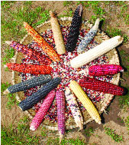
Comparing Cultures
Ethnocentrism – tendency to judge other cultures exclusively by the standards of one’s own
E.g. Hopis and corn
Notes:
Using our own culture norms into other cultures.

Slide 19
Comparing Cultures
Cultural Relativism
A foreign culture should not be judged by the standards of a home culture
Behaviour or/and way of thinking must be examined in its cultural context, i.e. in terms of the society’s values, norms, beliefs, and history
‘Body Rituals Among the Nacirema’ (Miner, 1956)
Notes:
Try to understand their culture using their standard. That’s the way we should compare culture. Cultural context.

Slide 20
Comparing Cultures
Mainstream Culture
Subculture
Counterculture

Slide 21
‘Mainstream’ Culture
Beliefs, values embraced and objects used by dominant groups
‘the norm’, or ‘the standard’
‘majority culture’; ‘dominant culture’

Slide 22
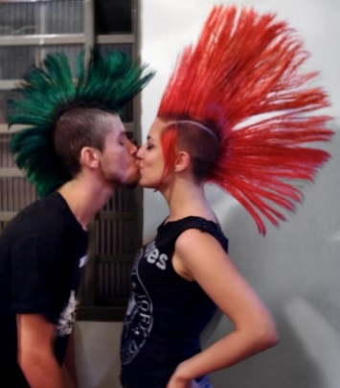
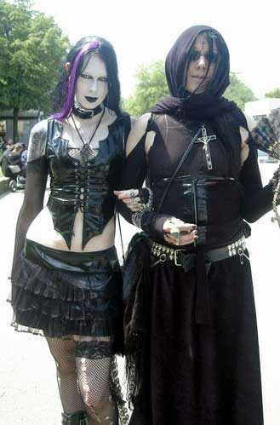
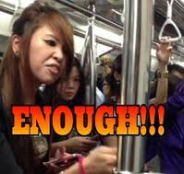
Subculture
A set of distinctive values, norms, and practices within a larger culture
Remains compatible with dominant culture
E.g. youth subculture, punks, goth
People do not fit neatly into one subculture or another – e.g. lesbian and ‘Ah-Lian’; etc.

Slide 23
Counterculture
Subversive; opposes dominant values and seeks to replace them (cultural equivalent of ‘political opposition’)
Countercultures express the ethos, aspirations, and dreams of a specific group or population during a particular time period
Notes:
Choose to go against the norms, and this is a resistance. Hippie culture example.

Slide 24
Theorising Culture
Functionalism
Symbolic Interactionism
Conflict Perspective

Slide 25
Analysing Culture
Functionalism
Sees Culture as stable, highly integrated system
Norms and sanctions to keep society stable, cohesive
Shared values
E.g. Singapore’s Five Shared Values
Nation before community and society above self
Family as the basic unit of society
Community support and respect for the individual
Consensus, not conflict
Racial and religious harmony

Slide 26
Analysing Culture
Functionalism – Critique
Although sharing a common language and core values may pivot towards harmony and consensus, societies also contain dysfunctions
Inequalities in terms of class, gender, and race
Presence of subcultures may lead to a lack of consensus with regard to core or shared values
Notes:
Overemphasis in terms of harmony. And differences and inequalities is a part of reality that lead to disharmony. Social order, inequalities and harmony are the key words.

Slide 27
Analysing Culture
Symbolic Interactionism
Interested in cultural symbols & interaction
People as active producers and interpreters of Culture
How people make sense of the world
Construction of meaning in interaction processes
E.g. lighting a candle
Notes:
Social interaction at the micro level. Meaning is constructed in social encounter.

Slide 28
Analysing Culture
Symbolic Interactionism – Critique
Lack of attention to larger, macro-level social structures
Cannot predict any changes or how meanings actually change
Over-emphasis with small-group interactions
Notes:
This perspective doesn’t explain changes in social norms.

Slide 29
Analysing Culture
Conflict Perspective
Sees Culture as an arena of social conflict
Values and norms help to create and sustain the privileged position of the powerful
E.g. Fashion industry (industry owners making profits; p.21)
Notes:
People are more wealthy can decide the fashion trend so that we need to follow. One groups becomes dominant, and this group will use their power to stress the social inequality.

Slide 30
Analysing Culture
Conflict Perspective – Critique
Focuses more on societal discord
Overemphasis on the tensions and divisiveness of Culture
Little micro-level analysis
Notes:
Is the society the source of conflict and always so conflicted?

Slide 31
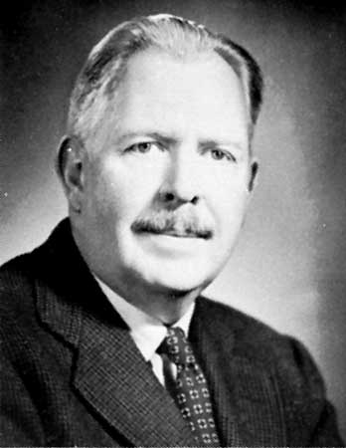
Culture & Globalisation
Globalisation of Culture
Watching BBC, CNN, Al-Jazeera
I. Globalisation of Culture is not new
Ralph Linton’s article
Colonialism
Missionaries

Slide 32
Culture & Globalisation
II. Globalisation of Culture is not a one-way process
Does not merely lead to Westernisation or Americanisation (‘cultural imperialism’)
Does not lead to a homogenisation of Culture
Glocalisation – Culture that is both global and local simultaneously; reconfigure global forms in local contexts
Notes:
Adaptations

Slide 33
Culture & Globalisation
III. Globalisation leads to changes and/or adaptations in the way of life (Culture)
Showing at the same time, the open-endedness of Culture (add/drop)
MTV Brazil, MTV Asia, MTV India
McDonald’s

Slide 34
Definitions/ Components
1. Shared way of life
2. Meanings; symbols
3. Enculturation
4. Non-static
Concepts
1. Ethnocentrism
2. Cultural relativism
3. Mainstream culture
4. Subculture
5. Counterculture
Theorising Culture
1. Functionalism
2. Symbolic Interactionism
3. Conflict
Globalisation
1. Not new nor one-way process.
2. Not homogeneous
3. Glocalisation
4.Changes/adaptation

